Slide 1
React js
Lecture 5

Slide 2
AGendA
Recap last lecture points
What is Redux ?
Redux components
Getting started with store
Context
Redux vs Context

Slide 3
Redux
To use Redux in your react
app you need to install it
first :
Redux is a predictable state container and the state of your application is kept in a store, and each component can access any state that it needs from this store.
https://redux.js.org/introduc tion/getting-started
npm install redux&toolkit
react-redux

Slide 4
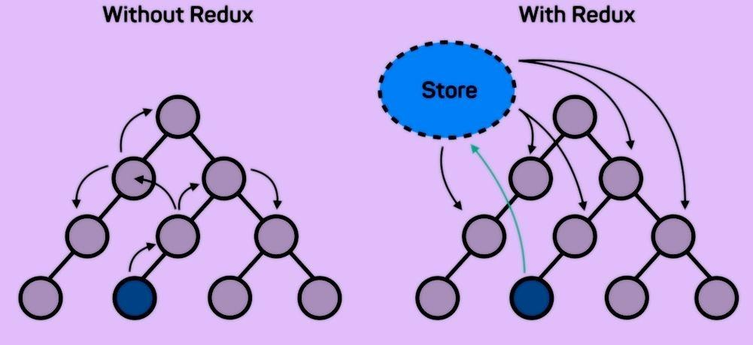
Redux

Slide 5
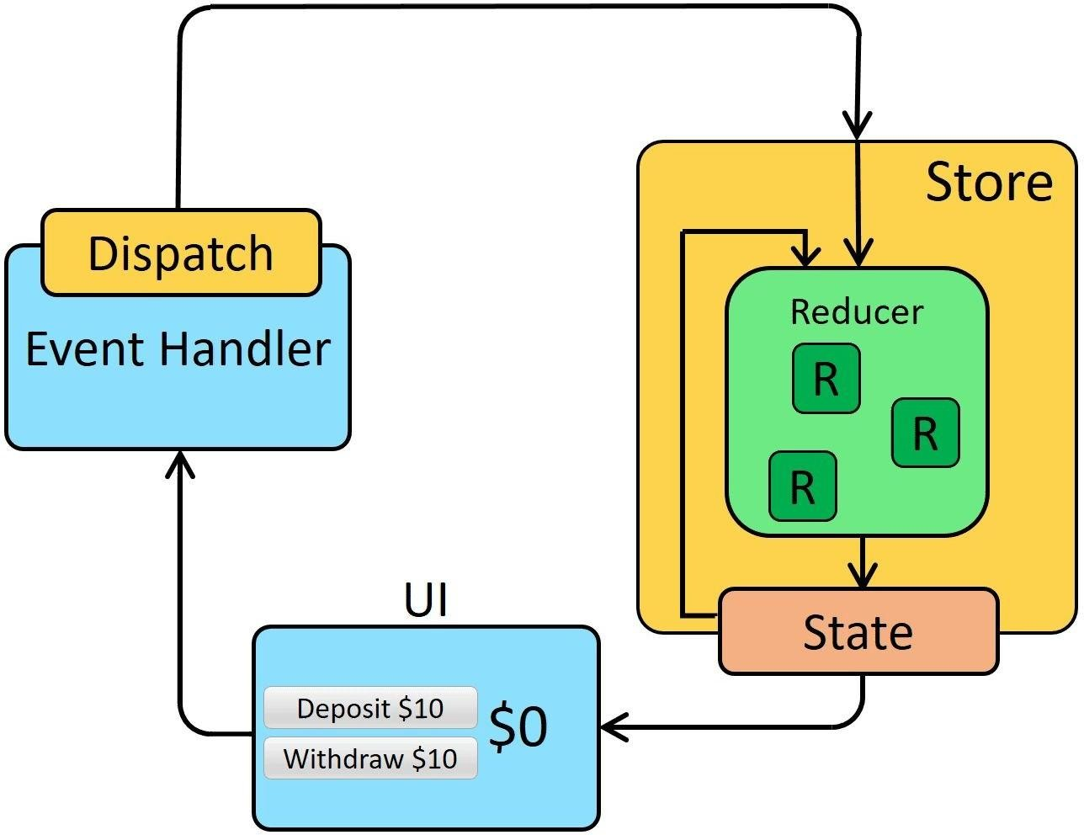
HOw Redux wOrks
There is a central store that holds the entire state of the application. Each component can access the stored state without having to send down props from one component to another.
There are three building parts:
actions
store
reducers

Slide 6
HOw Redux wOrks : AcTiOns
Actions are plain JavaScript objects, and they must have a type property to indicate the type of action to be carried out.
Example :
const setUsername = (payload) => {
return {
type: "LOGIN", payload: payload
}
}

Slide 7
HOw Redux wOrks : Reducers
Reducers are pure functions that take the current state of an application, perform an action, and return a new state. These states are stored as objects, and they specify how the state of an application changes in response to an action sent to the store.

Slide 8
HOw Redux wOrks :
import * as types from "./types";
export default (state = {}, action) => { switch (action.type) {
case type: return {
...state,
...action.payload,
};
default:
return state;
}
};

Slide 9
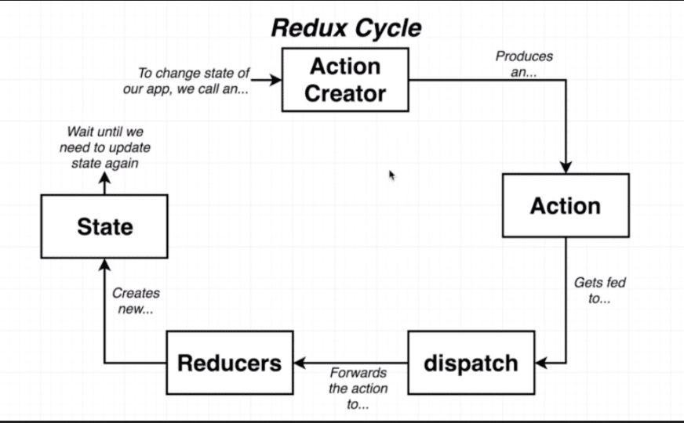
HOw Redux wOrks : STOre
The store holds the application state.
There is only one store in any Redux application.

Slide 10
HOw Redux wOrks : WrAp
AppLicATiOn wiTH Redux
<Provider store={store}>
<App />
</Provider>

Slide 11
UseSeLecTOR()
To read and get different store values
Syntax : const state = useSelector(state => state)
UseDispATCH()
To Update store values and dispatch
actions Syntax : const dispatch = useDispatch();
dispatch(action());

Slide 12
When to Use
ConTexT
Context provides a way to pass data through the component tree without having to pass props down manually at every level.
Context
Context is designed to share data that can be considered “global” for a
tree of React components, such as the current authenticated user, theme, or preferred language.

Slide 13
ConTexT VS Redux
If you are using Redux only to avoid passing props down to deeply nested components, then you could replace Redux with the Context API. It is exactly intended for this use case.
On the other hand, if you are using Redux for everything else (handling your application's logic outside of your components, centralizing your application's state, using Redux DevTools to track when, why, and how your application's state changed, or using plugins such as Redux Form, Redux Saga, etc…), then there is absolutely no reason for you to abandon Redux.
The Context API doesn't provide any of this.

Slide 14
ConTexT : CReATe conTexT
Create context file config :
import React from "react";
const contextFeature = React.createContext();
export const contextProvider= contextFeature.Provider;
export default contextFeature ;

Slide 15
ConTexT : Use conTexT
- Wrap | the components that needs to have the | provider | values
with | context provider:
const [value, setValue] = useState(initial value);
<contextProvider
<clild />
</contextProvider>
value={{ value, setValue}}>
- In child component you can use and set context value using useContext hook
const {value , setValue} = useContext(contextFeature )

Slide 16
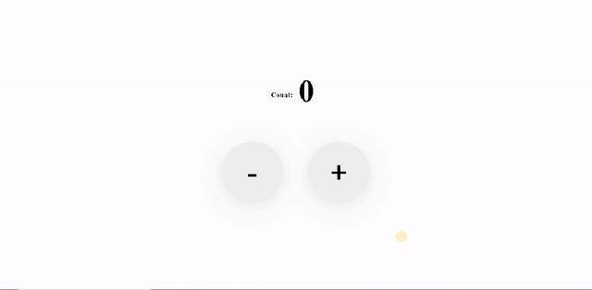
TAsk :COunTeR App
Home Products Books counter(2) login
Counter app
Create a new page called counter with the following requirements :
Add link to navbar with counter page and counter number should be updated in navbar with counter
Counter component with + / - and reset counter number , make sure that counter values not less than 0
Please use redux cycle with counter to read and update counter number from store

Slide 17
ADD to fav
Home Products Books counter(2) fav(1)
login
Make moives page ,
Add functionality add to fav and show cart counter in navber.
And make fav icon clickable to show fav items in cart page with quantity and options to increase or decrease item quantity and make page for moive det
Link api :https://api.themoviedb.org/3/movie/popular?api_key=7a1c19ea3c361a4d3cc53eb70ef8298c
To show image put this code in src attributie
src={`https://image.tmdb.org/t/p/w500/${data.poster_path}`}
Add to fav
Add to fav
Add to fav

Slide 18
ResouRces
React links :
https://www.youtube.com/watch?v=Dorf8i6lCuk
https://www.youtube.com/watch?v=w7ejDZ8SWv8&t=2559s
https://www.youtube.com/watch?v=0riHps91AzE
Chat with firebase https://www.youtube.com/watch?v=zQyrwxMPm88
Medhat Dawoud Channel :
https://www.youtube.com/channel/UCuwTHYdMavwEPsZ6OAkXfi g
Mosh channel : https://www.youtube.com/channel/UCWv7vMbMWH4-V0ZXdmDpPB A
Formik in deep : https://www.youtube.com/watch?v=a94FOvaBomQ&list=PLC3y8-rFHvwiPmFbtzEWj ESkqBVDbdgGu

